Slide 1
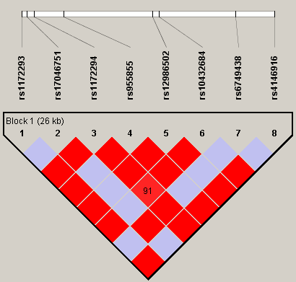
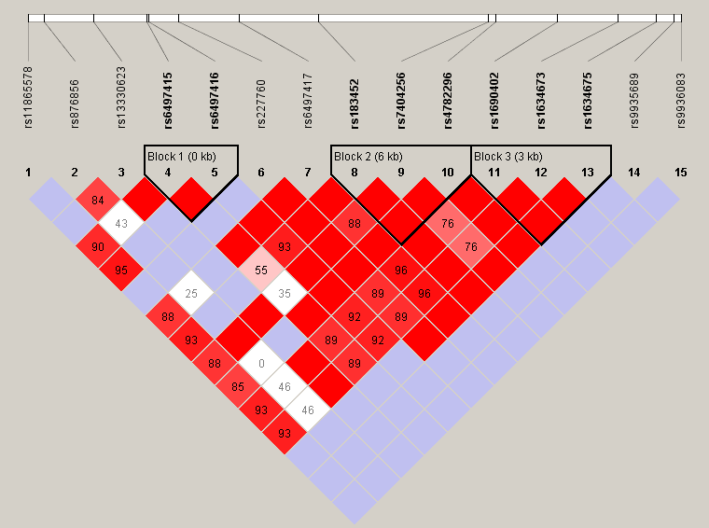
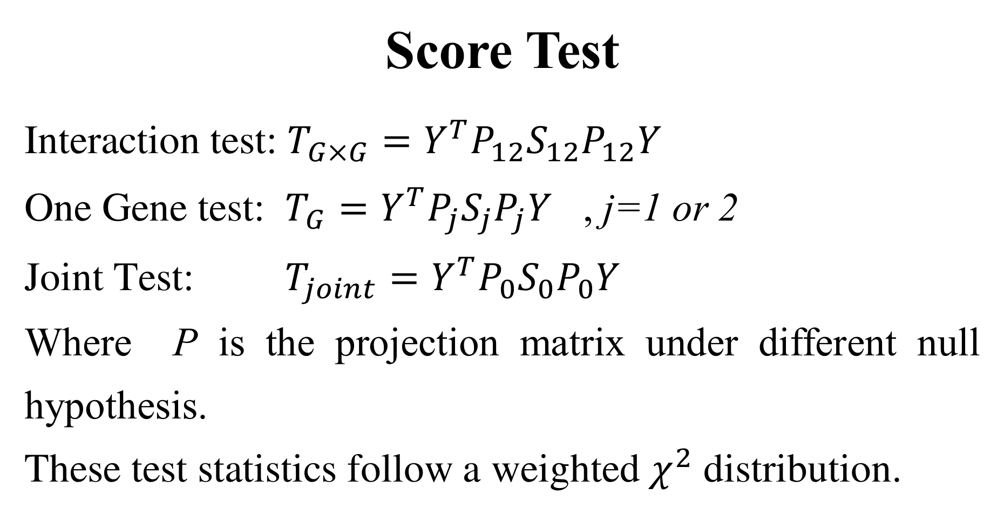
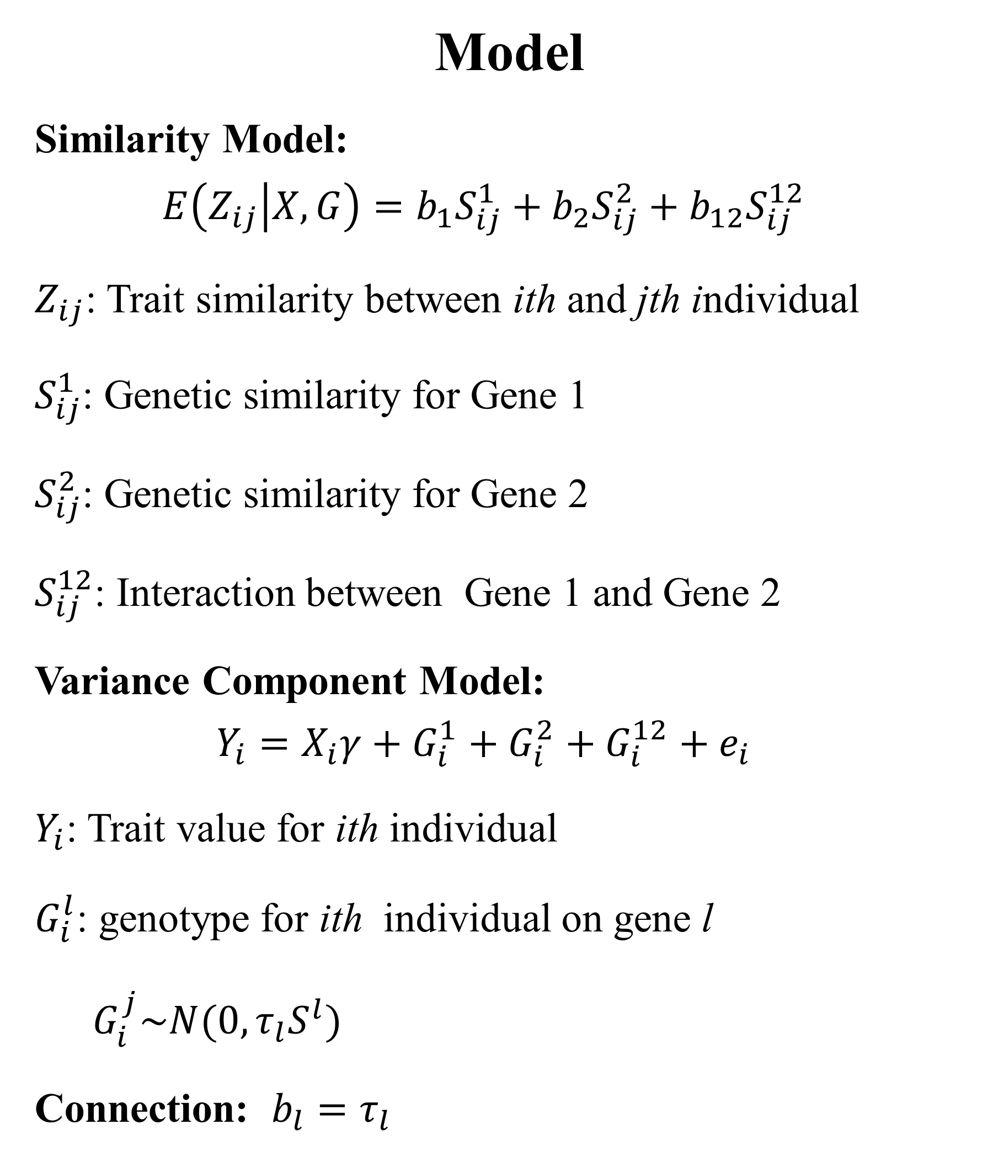
NC STATE UNIVERSITY
Gene-set Analysis For Gene-Gene Interactions Using Gene-Trait Similarity Regression
Xin Wang and Jung-Ying Tzeng
Bioinformatics Research Center, North Carolina State University, Raleigh, NC 27695
Introduction
Gene-set analysis has drawn great attention in recent genome-wide and sequence-based association studies. While most gene-set methods have concentrated on detecting genetic main effects, here we focus on methods for studying gene-gene (GxG) interactions. The gene-set GxG method we present focuses on quantitative traits and uses pairwise genetic similarity as a tool to aggregate marker information.
Score Test
Interaction test: $T_{G×G}=Y^{T}P_{12}S_{12}P_{12}Y$
One Gene test: $T_{G}=Y^{T}P_{j}S_{j}P_{j}Y$ , j=1 or 2
Joint Test: $T_{joint}=Y^{T}P_{0}S_{0}P_{0}Y$
Where P is the projection matrix under different null hypothesis.
These test statistics follow a weighted $χ^{2}$ distribution.
Objective
Develop a framework for incorporating gene-gene interaction effects in similarity-based methods.
Propose a series of tests to suit different purposes
test for detecting GxG interactions
test for detecting marginal main effects for one gene adjust by the other gene
joint test for detecting the overall association induced either by genetic main effects or by GxG interactions.
Simulation
Based on 2 Candidate genes for BMI
Consider 2 factors: LD and MAF
Compare with PCA and PLS
Model
Similarity Model:
$$E\left(Z_{ij} | X,G\right)=b_{1}S_{ij}^{1}+b_{2}S_{ij}^{2}+b_{12}S_{ij}^{12}$$
$Z_{ij}$: Trait similarity between ith and jth individual
$S_{ij}^{1}$: Genetic similarity for Gene 1
$S_{ij}^{2}$: Genetic similarity for Gene 2
$S_{ij}^{12}$: Interaction between Gene 1 and Gene 2
Variance Component Model:
$$Y_{i}=X_{i}γ+G_{i}^{1}+G_{i}^{2}+G_{i}^{12}+e_{i}$$
$Y_{i}$: Trait value for ith individual
$G_{i}^{l}$: genotype for ith individual on gene l
$G_{i}^{j}\sim N(0, τ_{l}S^{l})$
Connection: $b_{l}=τ_{l}$
SNP | 1 | 2 | 3 | 4 | 5 | 6 | 7 | 8
LD | H | L | L | H | H | H | L | H
MAF | R | R | C | R | R | R | R | R
SNP | 1 | 2 | 3 | 4 | 5 | 6 | 7 | 8 | 9 | 10 | 11 | 12 | 13 | 14 | 15
LD | H | L | L | H | H | L | H | H | H | H | H | H | L | L | L
MAF | R | R | R | R | R | R | C | C | C | C | C | C | R | R | R
RBJ
GPRC5B
Summary
On average, our method is better than PCA and PLS.
the bigger the MAF, the larger power
the higher LD, the larger the power
When the casual SNP is in Low LD, and the MAF is quite small, our method does not perform as good as the other two methods test for detecting GxG interactions
Further Study
Apply the method to real data
Extent the method to Genome wide research

